Slide 1
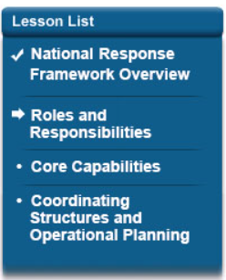
Lesson Overview
The National Response Framework is intended to strengthen, organize, and coordinate response actions across the entire response community as a means of delivering the core response capabilities in order to stabilize the community lifelines. This lesson describes community lifelines and the core capabilities for response.
At the end of this lesson, you will be able to identify core capabilities for response and how they are used to stabilize community lifelines.

Slide 2

Response Partnerships
An effective, unified national response requires layered, mutually supporting capabilities. Individuals and communities, the private and nonprofit sectors, faith-based organizations, and all levels of government should understand their respective roles and responsibilities and how to complement each other in achieving shared goals. The video below provides more information on effective response partnerships.

Slide 3
Communities
Communities are groups that share goals, values, and institutions, but are not always bound by geographic boundaries or political divisions.
They may be:
Communities provide opportunities for sharing information and promoting collective action. Engaging these communities in preparedness efforts is important to identifying their needs and taking advantage of their potential contributions.
You can learn more about strategies for community preparedness by completing IS-909 Community Preparedness: Implementing Simple Activities for Everyone (https://training.fema.gov/is/courseoverview.aspx?code=IS-909).
Private Sector | Health and Medical
Individuals and families | NGOs
Faith-based organizations | Neighborhood partnerships
Advocacy groups | Academia
Social and community groups associations

Slide 4

Community Involvement Example
A Core Advisory Group (CAG) consists of people with cross-disabilities who advise emergency managers about accessibility. During a 2015 disaster response to a U.S. territory, there was no pre-existing CAG. Responders had to learn what sign languages were used; how many sign language interpreters were in the territory; whether congregate living existed; which local support, service, and advocacy entities existed; whether auxiliary aids existed in the territory; and what devices and equipment were present.
As events were unfolding during disaster response, there were rumors that needed to be verified regarding people with disabilities who lacked services and were unsafe. Rumors were verified and people were transitioned to appropriate temporary shelters. CAG members now serve in the EOC to help facilitate information and develop courses of action to meet the needs of citizens with disabilities and those of older individuals.

Slide 5
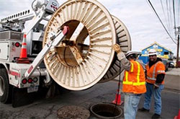
The Private Sector
Private sector organizations engage in incident response through their own internal response and continuity actions, the commodities they provide, their partnerships with each level of government, and their roles within the supply chain. Elements of the private sector are most often the providers of community lifeline services and have a key interest in the stabilization and restoration of their own operations and those of other infrastructure systems.
The private sector, comprised of small, medium, and large businesses, spans nationally significant infrastructure to locally owned and operated businesses that, while small, are staples of the community. The private sector includes commerce; healthcare; private, cultural, and educational institutions; and industry, as well as public/private partnerships that have been established specifically for emergency management purposes.
Refer to page 26 of the National Response Framework for additional information.

Slide 6
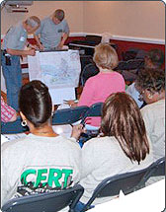
Individuals, Families, and Households
Individuals, families, and households play an important role in emergency preparedness and response. You can contribute by:
  Reducing hazards in and around your home
  Preparing an emergency supply kit and household emergency plan
  Monitoring emergency communications carefully
  Volunteering with an established organization
  Enrolling in emergency response training courses

Slide 7

Nongovernmental Organizations (NGOs)
NGOs play vital roles at the local, state, tribal, territorial, insular-area, and Federal levels in delivering important services, including those associated with the response core capabilities:
  Identifying sheltering locations, ensuring access to those facilities, and communicating their locations to the whole community;
  Providing emergency commodities and services, such as water, food, shelter, assistance with family reunification, clothing, and supplies for post-emergency cleanup;
  Supporting the evacuation, rescue, care, and sheltering of animals displaced by the incident;
  Supporting search and rescue, transportation, and logistics services;
  Identifying and supporting the heath, medical, mental health, and behavior health resources of the impacted community; and
  Supporting disaster survivors, identifying unmet needs, and developing individual recovery plans.

Slide 8
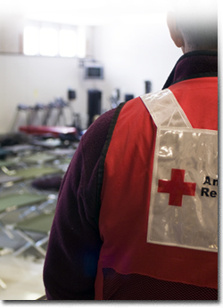
Nongovernmental Organizations (NGOs), (cont'd)
Some NGOs are officially designated as support elements to national response capabilities:
  The American Red Cross is chartered by Congress to provide relief to survivors of disasters and help people prevent, prepare for, and respond to emergencies.
  National Voluntary Organizations Active in Disaster (National VOAD) is an association of organizations that mitigates and alleviates the impact of disasters; provides a forum promoting cooperation, communication, coordination and collaboration; and fosters more effective delivery of services to communities impacted by a disaster. National VOAD is a consortium of over 70 national organizations and 56 territorial and state equivalents.
  National Center for Missing & Exploited Children (NCMEC): Within the NCMEC, the National Emergency Child Locator Center (NECLC) facilitates the expeditious identification of children and their reunification with their families.
Visit the Volunteer and Donations Management Support Annex (https://www.fema.gov/media-library/assets/documents/32282) to learn more.

Slide 9
Knowledge Review 1
What is the role of Private Sector Organizations in incident Response and what are some examples of Private Sector Organization?
Be prepared to discuss your answer.

Slide 10
Knowledge Review 2
Based on the information presented, let's take a few minutes to discuss how individuals and families play an important role in emergency preparedness?
Be prepared to discuss your answer.

Slide 11
Local Government
The responsibility for responding to natural and human-caused incidents that have recognizable geographic boundaries generally begins at the local level.
Local police, fire, emergency medical services, public health and medical providers, emergency management, public works, environmental response professionals, and other local responders are often the first to detect a threat or hazard or respond to an incident, and frequently they are the last to leave an incident site.
Local governments manage the vast majority of incidents that occur each day.

Slide 12
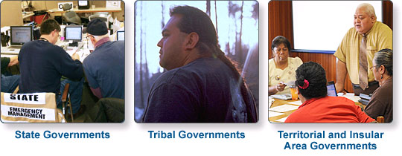
State, Tribal, Territorial, and Insular Area Governments
State, tribal, territorial, and insular-area governments are responsible for the health and welfare of their residents, communities, lands, and cultural heritage.

Slide 13
State Governments
When an incident expands or has the potential to expand beyond the capability of a local jurisdiction and responders cannot meet the needs with mutual aid and assistance resources, local officials contact the state.
State governments supplement local efforts by applying in-state resources first. If additional resources are required, states can request assistance from other states through interstate mutual aid and assistance agreements such as the Emergency Management Assistance Compact (EMAC). If a state anticipates that its resources may be exceeded, the governor may request assistance from the Federal Government through a Stafford Act declaration.
EMAC is:
  Administered by the National Emergency Management Association
  An interstate mutual aid agreement
  A way to streamline the interstate mutual aid and assistance process
Visit the EMAC Website (https://www.emacweb.org) to learn more.

Slide 14
State Response: Key Players
States support their local governments, which are closest to those impacted by incidents.
State department and agency heads and their staffs develop, plan, and train on internal policies and procedures to meet response and recovery needs. They also participate in interagency training and exercises to develop and maintain the necessary capabilities.
They are vital to the state’s overall emergency management program, as they bring expertise spanning various response functions and serve as core members of the state Emergency Operations Center (EOC) and Incident Command Posts (ICPs).

Slide 15
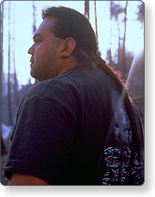
Tribal Governments
The United States has a trust relationship with federally recognized Indian tribes and recognizes tribes as sovereign nations. Under the Stafford Act, federally recognized Indian tribes can directly request their own emergency declaration and major disaster declaration, or they can request assistance under a state request.
The Chief Executive is responsible for public safety and welfare:
  Coordinates resources needed to respond to incidents of all types
  Makes, amends, or suspends certain orders or regulations associated with the response in accordance with the law
  Communicates with the public in an accessible manner and helps people, businesses, and organizations cope with the consequences of any type of incident
  Negotiates mutual aid and assistance agreements with other local jurisdiction, state, tribal, territorial, and insular-area governments
  Requests Federal assistance
Visit the website Tribal Coordination Support Annex (https://www.fema.gov/media-library/assets/documents/32279) to learn more.

Slide 16
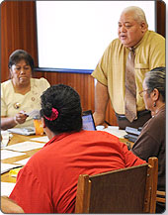
Territory and Insular Area Governments
Territorial and insular area governments are responsible for coordinating resources to address actual or potential incidents and have many of the same functions states have, as previously listed in this section. Because of their remote locations, territorial and insular area governments often face unique challenges in receiving assistance from outside the jurisdiction quickly and often request assistance from neighboring islands, other nearby countries, states, the private sector or NGO resources, or the Federal Government.
Additionally, there are language and cultural differences that must be considered, as well as the potential for authorities that overlap with federal authorities.

Slide 17

Federal Government
The Federal Government maintains a wide range of capabilities and resources that may be required to deal with domestic incidents in order to save lives and protect property and the environment while ensuring the protection of privacy, civil rights, and civil liberties.
The Federal Government becomes involved with a response when Federal interests are involved; when state, local, tribal, or territorial governments request assistance; or as authorized or required by statute, regulation, or policy.
Visit the website NRF (https://www.fema.gov/media-library/assets/documents/117791) to read page 34 to learn more.

Slide 18
Knowledge Review 2
Based on the information presented, review each of the Federal Response Key Players.
Be prepared to discuss your answer.

Slide 19
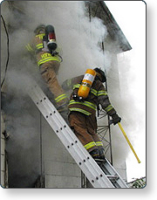
Types of Federal Aid (1 of 2)
Federal Response and Assistance Available Without a Stafford Act Declaration
The National Response Framework covers the full range of complex and constantly changing requirements in anticipation of, or in response to, threats or actual incidents. In addition to Stafford Act support, the National Response Framework or other supplementary or complementary operational plans may be applied to respond or provide other forms of support.
Immediate lifesaving assistance to states and other types of assistance, such as wildland firefighting support or response to an agricultural disease or cybersecurity incident, are performed by Federal departments or agencies under their own authorities and funding or through reciprocal mutual assistance agreements.
Federal-to-Federal Support
A Federal department or agency responding to an incident under its own authorities may also request support from the Secretary of Homeland Security in obtaining and coordinating additional Federal assistance.
Federal departments and agencies may execute interagency or intra-agency reimbursable agreements in accordance with the Economy Act or other applicable authorities.

Slide 20
Types of Federal Aid (2 of 2)
Requesting Federal Assistance
Federal Response and Assistance Under the Stafford Act Declaration
Federal support to States, Tribal nations, territories and insular areas, and local jurisdictions takes many forms. The most widely known authority under which assistance is provided for major incidents is the Stafford Act.

Slide 21
Knowledge Review 4
When do State Governments respond to incidents?

Slide 22
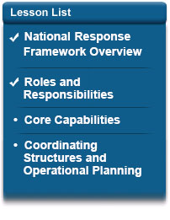
Lesson 2 Summary
In this lesson, you learned how the National Response Framework defines the response roles and responsibilities of all elements of the whole community.
The next lesson presents the core capabilities for the Response mission area and the actions required to build and deliver these capabilities.

